Slide 1
Biot-Savart law

Slide 2
Presentating
Team Leader : Salauddin
Team Member : Sajib
Team Member : Sarna
Team Member : Sabuj
Team Member : Manik

Slide 3
Introduction
Biot-Savart law is a fundamental law in electromagnetism it
describes the magnetic field created by a current-carrying wire
Discovered by French physicists Jean-Baptiste Biot and Félix Savart in 1820

Slide 4
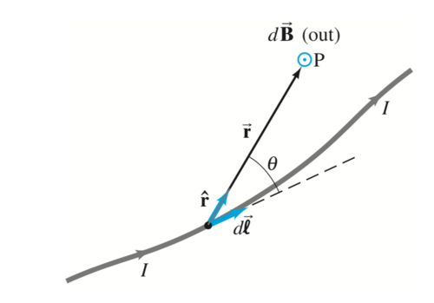
Statement of the Law
The magnetic field (B) created by a current (I) flowing through a wire is proportional to the current and the length of the wire.
B is also inversely proportional to the distance (r) from the wire.
The formula for the Biot-Savart law is: B = (μ₀ / 4π) * I * (dL x r) / r³
Where μ₀ is the permeability of free space and dL is a small element of the wire carrying the current.

Slide 5
Example Calculation
Suppose we have a long straight wire carrying a current of 2 A.
We want to calculate the magnetic field at a point 0.1 m away from the wire.
Using the Biot-Savart law, we get B = (μ₀ / 4π) * 2 * (dL x r) / r³ = (μ₀ / 4π) * 2 * (dL / 0.1) / 0.1³ = 1.26 x 10^-5 T.

Slide 6
Applications of the Biot-Savart Law
The Biot-Savart law is used to calculate the magnetic field created by a current-carrying wire or a group of wires.
It is used in many devices such as transformers, electric motors, and generators.
It is also used in medical applications such as magnetic resonance imaging (MRI).

Slide 7
Conclusion
The Biot-Savart law is a fundamental law in electromagnetism that is used to calculate the magnetic field created by a current-carrying wire.
It has many applications in technology and medicine.
Understanding the Biot-Savart law is essential for anyone studying electromagnetism.

